Slide 1
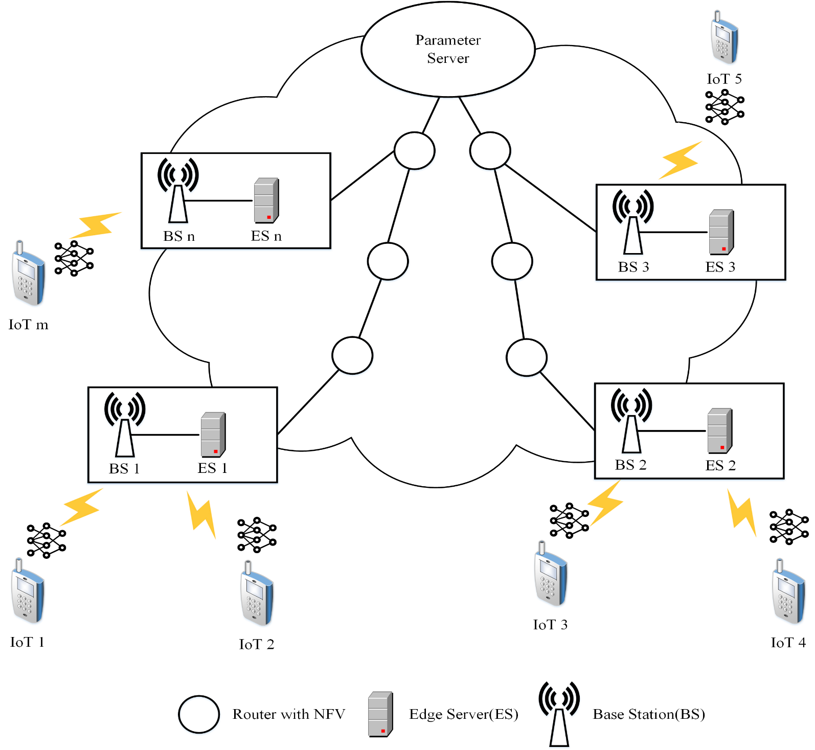
Edge Computing System Model
.
Nowadays, edge computing has been incorporated into the mobile cellular network (e.g. 5G), called multi-access edge computing (MEC), by having an edge server (ES) collocated with one or more base stations (BSs) or with radio access networks (RANs).
The system is decomposed into a number of wireless coverage areas, each of which is deployed with a based station (BS) to provide wireless connectivity to the clients visiting the area.
A BS is also equipped (or collocated) with an edge server (ES) to form an edge computing site which processes or forwards the data services from the clients.
ESs are connected with each other by a dedicated wide area network (WAN).

